Slide 1



Modelling and Simulation in Systems and Synthetic Biology
Morgan MADEC
ICube Laboratory, Strasbourg, France

Slide 2
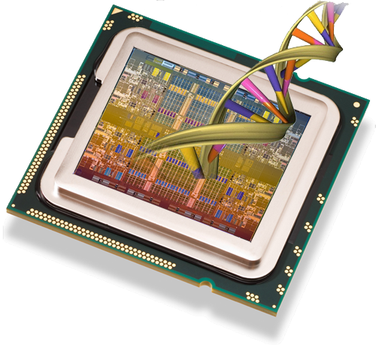
Outline of the workshop
Theoretical introduction
Biological systems modelling with Virtual Cell
From systems biology to synthetic biology
Discussion

Slide 3
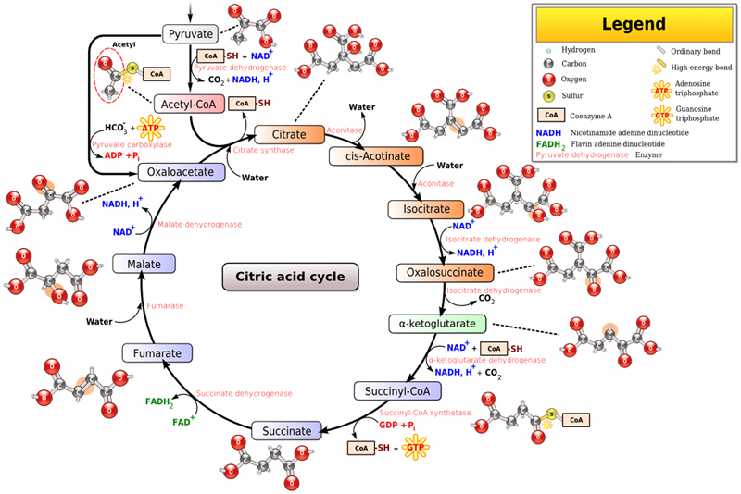
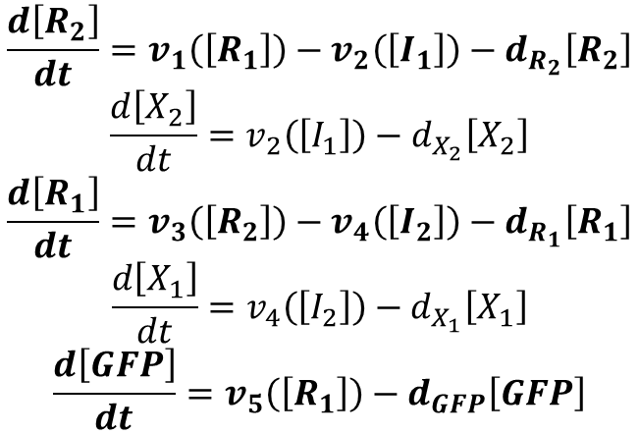
Theoretical introduction Background on biological systems modelling
$$\frac{d\left[R_{2}\right]}{dt}=v_{1}\left(\left[R_{1}\right]\right)−v_{2}\left(\left[I_{1}\right]\right)−d_{R_{2}}\left[R_{2}\right]$$
$$\frac{d\left[X_{2}\right]}{dt}=v_{2}\left(\left[I_{1}\right]\right)−d_{X_{2}}\left[X_{2}\right]$$
$$\frac{d\left[R_{1}\right]}{dt}=v_{3}\left(\left[R_{2}\right]\right)−v_{4}\left(\left[I_{2}\right]\right)−d_{R_{1}}\left[R_{1}\right]$$
$$\frac{d\left[X_{1}\right]}{dt}=v_{4}\left(\left[I_{2}\right]\right)−d_{X_{1}}\left[X_{1}\right]$$
$$\frac{d\left[GFP\right]}{dt}=v_{5}\left(\left[R_{1}\right]\right)−d_{GFP}\left[GFP\right]$$
Mathematical representation of a biological system.
Standard models (rate laws, Michaelis-Menten model, Hill’s equation).
Solving sets of differential equations (Euler’s method, advanced discretization schemes, etc …)

Slide 4
Representation of a biological system
A system composed of:
chemical species;
reactions that consume several species and produce other species;
regulations (positive or negative) of these reactions.
R2
R1
GFP
I2
X2
X1
I1

Slide 5
Representation of a biological system
In practice, regulation can be achieved in different ways:
Gene Regulatory Networks;
Enzymatic reactions;
mRNA-based regulation;
…

Slide 6
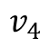
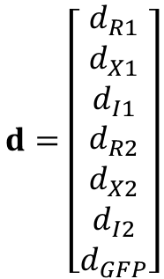
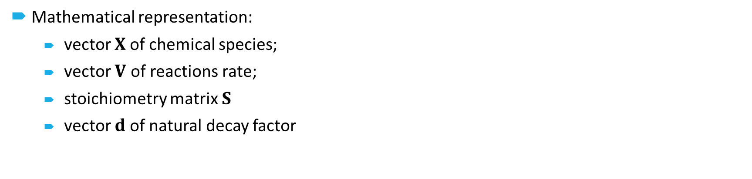
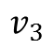
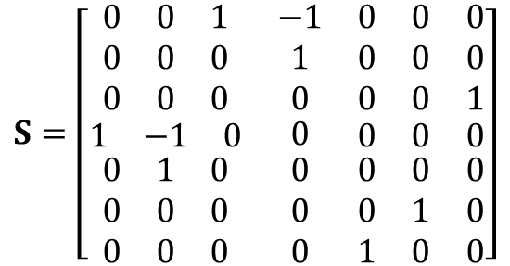
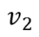
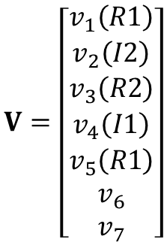
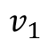
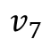
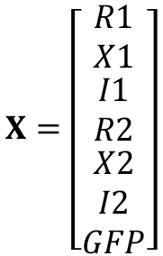
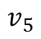
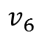
Representation of a biological system
Mathematical representation:
vector $X$of chemical species;
vector $V$ of reactions rate;
stoichiometry matrix $S$
vector $d$of natural decay factor
$$v_{1}$$
$$v_{3}$$
$$v_{5}$$
$$v_{2}$$
$$v_{4}$$
$$v_{6}$$
$$v_{7}$$
Species
$$X=\left[\begin{matrix}R1 \\ X1 \\ \begin{matrix}I1 \\ R2 \\ \begin{matrix}X2 \\ I2 \\ GFP\end{matrix}\end{matrix}\end{matrix}\right]$$
$$V=\left[\begin{matrix}v_{1}\left(R1\right) \\ v_{2}\left(I2\right) \\ \begin{matrix}v_{3}\left(R2\right) \\ v_{4}\left(I1\right) \\ \begin{matrix}v_{5}\left(R1\right) \\ v_{6} \\ v_{7}\end{matrix}\end{matrix}\end{matrix}\right]$$
$$S=\left[\begin{matrix}\begin{matrix}0 & 0 & 1 \\ 0 & 0 & 0 \\ 0 & 0 & 0\end{matrix} & \begin{matrix}−1 \\ 1 \\ 0\end{matrix} & \begin{matrix}0 & 0 & 0 \\ 0 & 0 & 0 \\ 0 & 0 & 1\end{matrix} \\ \begin{matrix}1 & −1 & 0\end{matrix} & 0 & \begin{matrix}0 & 0 & 0\end{matrix} \\ \begin{matrix}0 & 1 & 0 \\ 0 & 0 & 0 \\ 0 & 0 & 0\end{matrix} & \begin{matrix}0 \\ 0 \\ 0\end{matrix} & \begin{matrix}0 & 0 & 0 \\ 0 & 1 & 0 \\ 1 & 0 & 0\end{matrix}\end{matrix}\right]$$
$$d=\left[\begin{matrix}d_{R1} \\ d_{X1} \\ \begin{matrix}d_{I1} \\ d_{R2} \\ \begin{matrix}d_{X2} \\ d_{I2} \\ d_{GFP}\end{matrix}\end{matrix}\end{matrix}\right]$$
Reaction

Slide 7
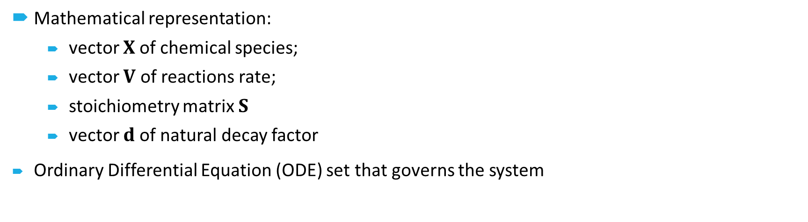
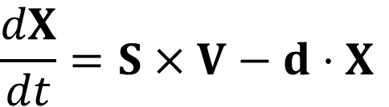
Representation of a biological system
Mathematical representation:
vector $X$of chemical species;
vector $V$ of reactions rate;
stoichiometry matrix $S$
vector $d$of natural decay factor
Ordinary Differential Equation (ODE) set that governs the system
$$v_{1}$$
$$v_{3}$$
$$v_{5}$$
$$v_{2}$$
$$v_{4}$$
$$v_{6}$$
$$v_{7}$$
$$\frac{dX}{dt}=S×V−d⋅X$$

Slide 8
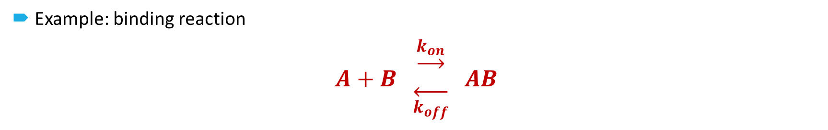
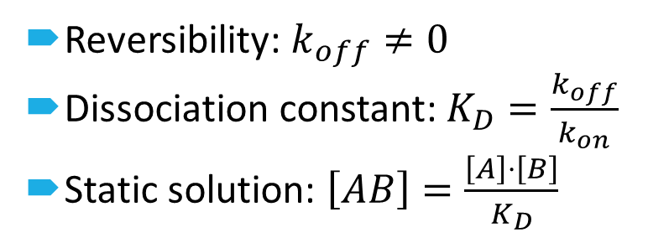
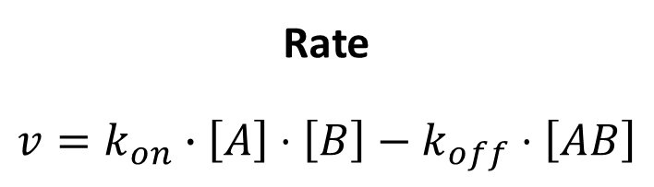
Standard models
First order chemical reaction
Example: binding reaction
$$A+B \begin{matrix}\underset{→}{k_{on}} \\ \overset{←}{k_{off}}\end{matrix} AB$$
Rate
$$v=k_{on}∙\left[A\right]⋅\left[B\right]−k_{off}⋅\left[AB\right]$$
Reversibility: $k_{off}≠0$
Dissociation constant: $K_{D}=\frac{k_{off}}{k_{on}}$
Static solution: $\left[AB\right]=\frac{\left[A\right]⋅\left[B\right]}{K_{D}}$

Slide 9
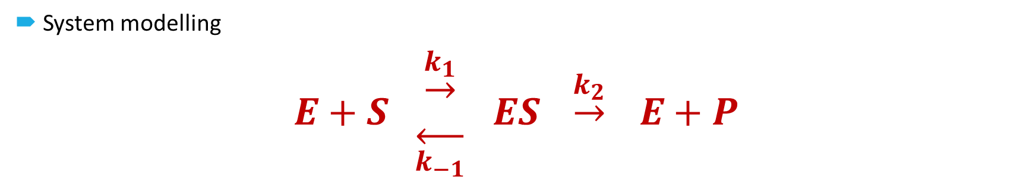
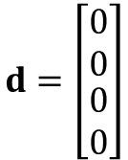
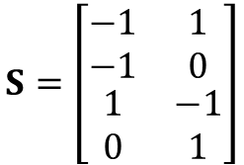
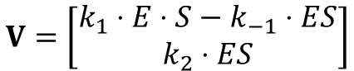
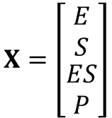
Standard models
Michaelis-Menten Model
System modelling
$$E+S \begin{matrix}\underset{→}{k_{1}} \\ \overset{←}{k_{−1}}\end{matrix} ES \underset{→}{k_{2}} E+P$$
$$X=\left[\begin{matrix}\begin{matrix}E \\ S\end{matrix} \\ \begin{matrix}ES \\ P\end{matrix}\end{matrix}\right]$$
$$S=\left[\begin{matrix}\begin{matrix}−1 \\ −1\end{matrix} & \begin{matrix}1 \\ 0\end{matrix} \\ \begin{matrix}1 \\ 0\end{matrix} & \begin{matrix}−1 \\ 1\end{matrix}\end{matrix}\right]$$
$$d=\left[\begin{matrix}\begin{matrix}0 \\ 0\end{matrix} \\ \begin{matrix}0 \\ 0\end{matrix}\end{matrix}\right]$$
$$V=\left[\begin{matrix}k_{1}⋅E⋅S−k_{−1}⋅ES \\ k_{2}⋅ES\end{matrix}\right]$$

Slide 10

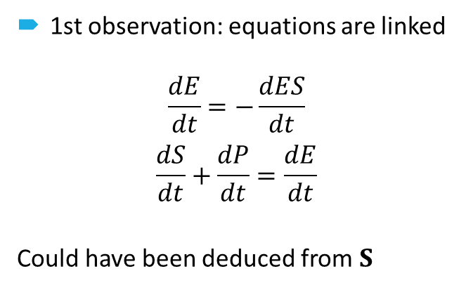
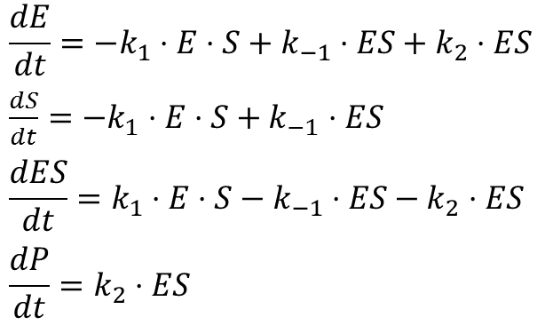
Standard models
Michaelis-Menten Model
Writing the ODE set
$$E+S \begin{matrix}\underset{→}{k_{1}} \\ \overset{←}{k_{−1}}\end{matrix} ES \underset{→}{k_{2}} E+P$$
$$\frac{dE}{dt}=−k_{1}⋅E⋅S+k_{−1}⋅ES+k_{2}⋅ES$$
$\frac{dS}{dt}=−k_{1}⋅E⋅S+k_{−1}$ $⋅ES$
$$\frac{dES}{dt}=k_{1}⋅E⋅S−k_{−1}⋅ES−k_{2}⋅ES$$
$$\frac{dP}{dt}=k_{2}⋅ES$$
1st observation: equations are linked
$$\frac{dE}{dt}=−\frac{dES}{dt}$$
$$\frac{dS}{dt}+\frac{dP}{dt}=\frac{dE}{dt}$$
Could have been deduced from $S$

Slide 11
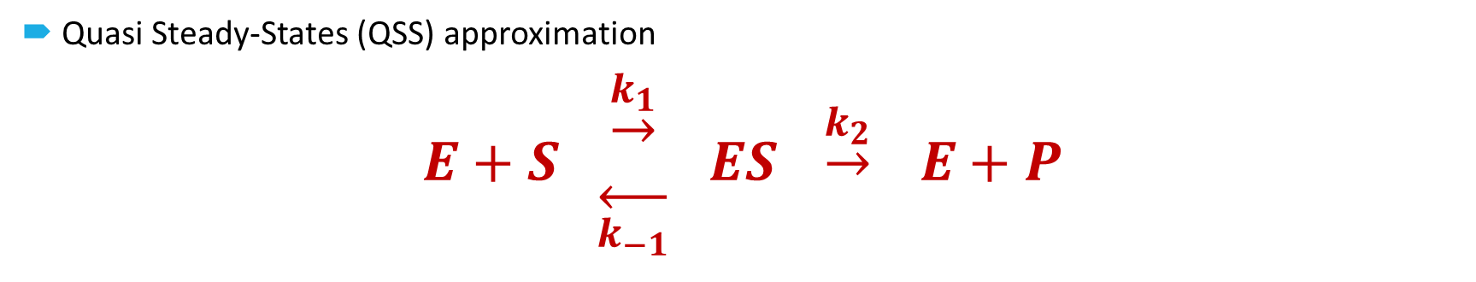
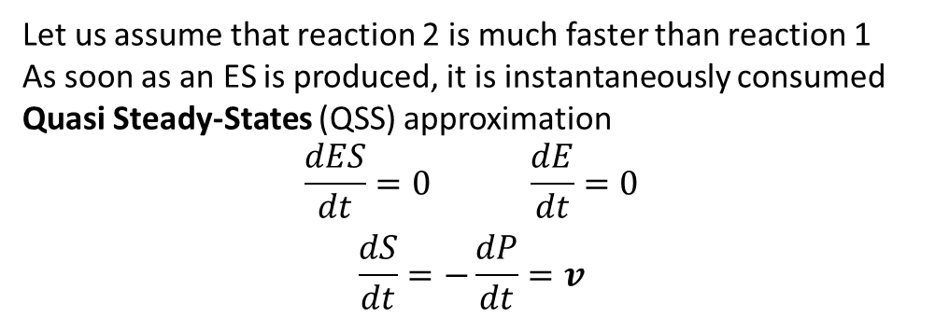
Standard models
Michaelis-Menten Model
Quasi Steady-States (QSS) approximation
$$E+S \begin{matrix}\underset{→}{k_{1}} \\ \overset{←}{k_{−1}}\end{matrix} ES \underset{→}{k_{2}} E+P$$
$$\frac{dE}{dt}=−k_{1}⋅E⋅S+k_{−1}⋅ES+k_{2}⋅ES$$
$\frac{dS}{dt}=−k_{1}⋅E⋅S+k_{−1}$ $⋅ES$
$$\frac{dES}{dt}=k_{1}⋅E⋅S−k_{−1}⋅ES−k_{2}⋅ES$$
$$\frac{dP}{dt}=k_{2}⋅ES$$
Let us assume that reaction 2 is much faster than reaction 1
As soon as an ES is produced, it is instantaneously consumed
Quasi Steady-States (QSS) approximation
$$\frac{dES}{dt}=0 \frac{dE}{dt}=0$$
$$\frac{dS}{dt}=−\frac{dP}{dt}=v$$

Slide 12

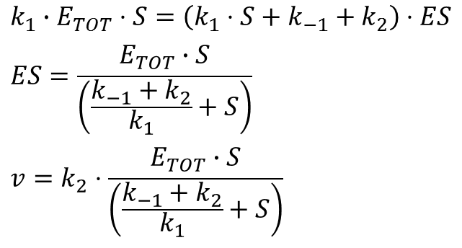
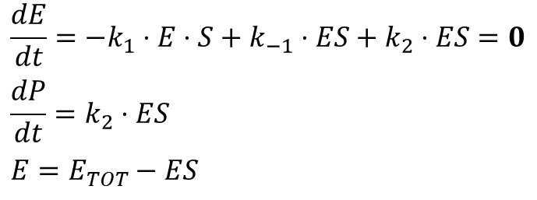
Standard models
Michaelis-Menten Model
Reaction rate
$$E+S \begin{matrix}\underset{→}{k_{1}} \\ \overset{←}{k_{−1}}\end{matrix} ES \underset{→}{k_{2}} E+P$$
$$\frac{dE}{dt}=−k_{1}⋅E⋅S+k_{−1}⋅ES+k_{2}⋅ES=0$$
$$\frac{dP}{dt}=k_{2}⋅ES$$
$$E=E_{TOT}−ES$$
$$k_{1}∙E_{TOT}⋅S=\left(k_{1}⋅S+k_{−1}+k_{2}\right)⋅ES$$
$$ES=\frac{E_{TOT}∙S}{\left(\frac{k_{−1}+k_{2}}{k_{1}}+S\right)}$$
$$v=k_{2}⋅\frac{E_{TOT}∙S}{\left(\frac{k_{−1}+k_{2}}{k_{1}}+S\right)}$$

Slide 13
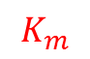
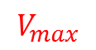
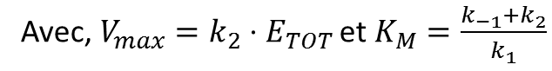
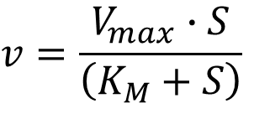
Standard models
Michaelis-Menten Model
Reaction rate
$$E+S \begin{matrix}\underset{→}{k_{1}} \\ \overset{←}{k_{−1}}\end{matrix} ES \underset{→}{k_{2}} E+P$$
$$V_{max}$$
$$v=\frac{V_{max}∙S}{\left(K_{M}+S\right)}$$
Avec,$V_{max}=k_{2}⋅E_{TOT}$ et $K_{M}=\frac{k_{−1}+k_{2}}{k_{1}}$
$$K_{m}$$

Slide 14
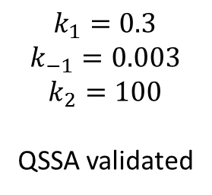
Standard models
Michaelis-Menten Model
Validity of QSS approximation
$$k_{1}=0.3$$
$$k_{−1}=0.003$$
$$k_{2}=100$$
QSSA validated

Slide 15
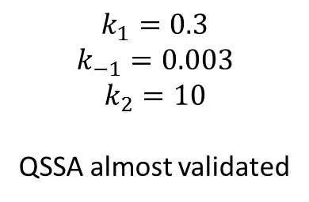
Standard models
Michaelis-Menten Model
Validity of QSS approximation
$$k_{1}=0.3$$
$$k_{−1}=0.003$$
$$k_{2}=10$$
QSSA almost validated

Slide 16
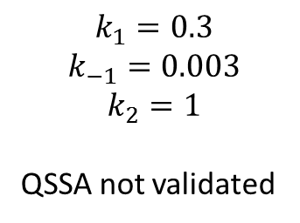
Standard models
Michaelis-Menten Model
Validity of QSS approximation
$$k_{1}=0.3$$
$$k_{−1}=0.003$$
$$k_{2}=1$$
QSSA not validated

Slide 17
Standard models
Michaelis-Menten Model
Validity of QSS approximation

Slide 18
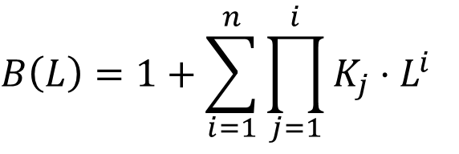
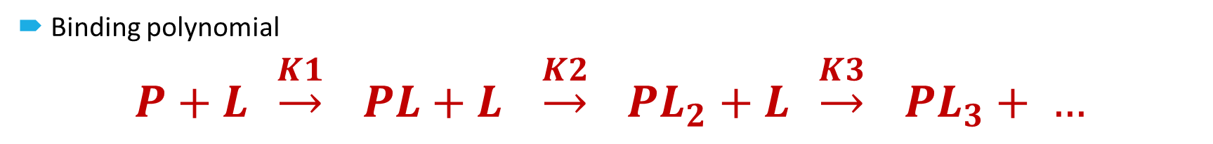
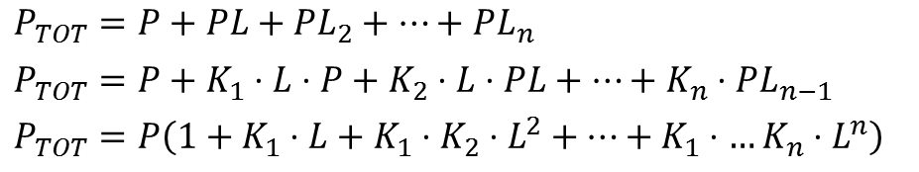
Standard models
Hill’s Equation
Binding polynomial
$$P+L \underset{→}{K1} PL+L \underset{→}{K2} {PL}_{2}+L \underset{→}{K3} {PL}_{3}+ …$$
With $K_{n}$ the association constant for each binding.
$$P_{TOT}=P+PL+{PL}_{2}+…+{PL}_{n}$$
$$P_{TOT}=P+K_{1}⋅L⋅P+K_{2}⋅L⋅PL+…+K_{n}⋅{PL}_{n−1}$$
$$P_{TOT}=P\left(1+K_{1}⋅L+K_{1}⋅K_{2}⋅L^{2}+…+K_{1}⋅…K_{n}⋅L^{n}\right)$$
Binding polynomial

Slide 19
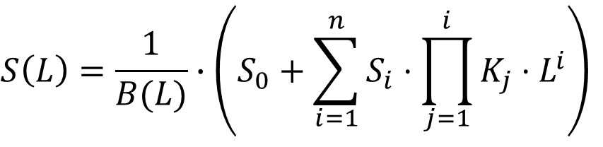
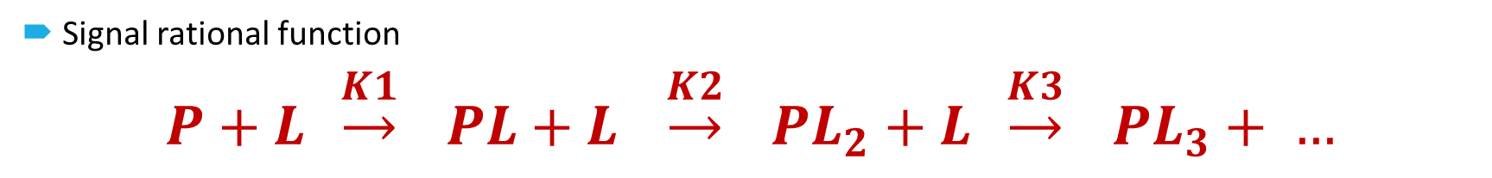
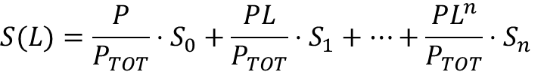
Standard models
Hill’s Equation
Signal rational function
$$P+L \underset{→}{K1} PL+L \underset{→}{K2} {PL}_{2}+L \underset{→}{K3} {PL}_{3}+ …$$
Now let’s assume that a signal (i.e. a reaction rate) depends on the number of bound L. Let $S_{n}$ the signal associated with ${PL}_{n}$
$$S(L)=\frac{P}{P_{TOT}}⋅S_{0}+\frac{PL}{P_{TOT}}⋅S_{1}+…+\frac{{PL}^{n}}{P_{TOT}}⋅S_{n}$$

Slide 20
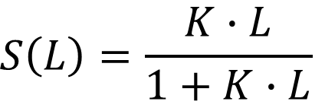
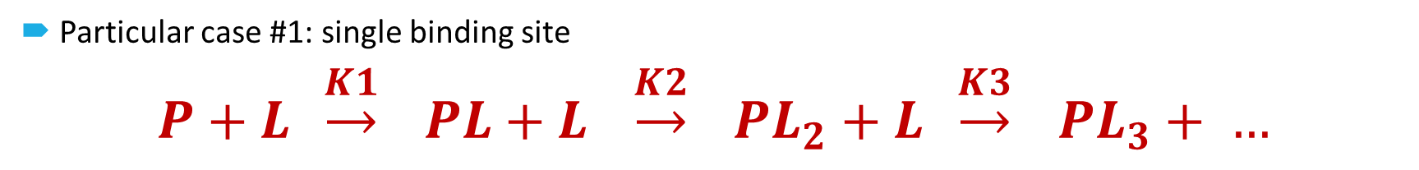
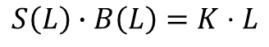
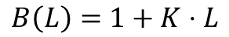
Standard models
Hill’s Equation
Particular case #1: single binding site
$$P+L \underset{→}{K1} PL+L \underset{→}{K2} {PL}_{2}+L \underset{→}{K3} {PL}_{3}+ …$$
Assumption: One binding site with an affinity $K$. Signal is equal to 1 when the site is occupied.
$B\left(L\right)=$ $1+K⋅L$
$$S\left(L\right)∙B\left(L\right)=K⋅L$$

Slide 21
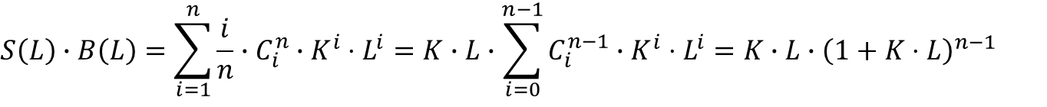
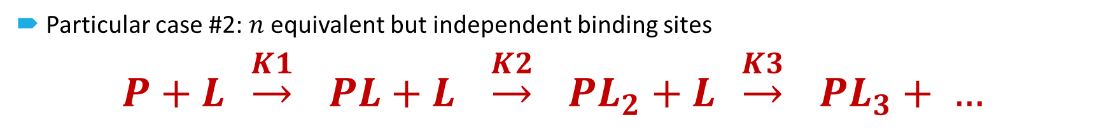



Standard models
Hill’s Equation
Particular case #2: $n$ equivalent but independent binding sites
$$P+L \underset{→}{K1} PL+L \underset{→}{K2} {PL}_{2}+L \underset{→}{K3} {PL}_{3}+ …$$
Assumption: Binding sites are independant but equivalent (with an association constant $K$) and the signal is proportional to the number of bound ligand.
$$B\left(L\right)=1+\sum_{i=1}^{n}{C_{i}^{n}∙K^{i}⋅L^{i}}={\left(1+K⋅L\right)}^{n}$$
For a given number of bound ligand, there are $C_{i}^{n}$ possible configurations with, for each, an affinity $K$
$$S\left(L\right)∙B\left(L\right)=\sum_{i=1}^{n}{\frac{i}{n}∙C_{i}^{n}∙K^{i}⋅L^{i}}={K∙L∙\sum_{i=0}^{n−1}{C_{i}^{n−1}∙K^{i}⋅L^{i}}=K∙L∙\left(1+K⋅L\right)}^{n−1}$$
$$S_{i}=\frac{i}{n}$$

Slide 22


Standard models
Hill’s Equation
Particular case #2: $n$ equivalent but independent binding sites
$$P+L \underset{→}{K1} PL+L \underset{→}{K2} {PL}_{2}+L \underset{→}{K3} {PL}_{3}+ …$$
Assumption: Binding sites are independant but equivalent (with an association constant $K$) and the signal is proportional to the number of bound ligand.
$$B\left(L\right)={\left(1+K⋅L\right)}^{n}$$
$$S\left(L\right)⋅B\left(L\right)={K∙L∙\left(1+K⋅L\right)}^{n−1}$$
Equivalent to a single site

Slide 23
Standard models
Hill’s Equation
Particular case #2: $n$ equivalent but independent binding sites
Example with 4 independant binding sites

Slide 24








Standard models
Hill’s Equation
Particular case #3: $n$ equivalent and cooperative binding sites
$$P+L \underset{→}{K1} PL+L \underset{→}{K2} {PL}_{2}+L \underset{→}{K3} {PL}_{3}+ …$$
Assumption : Binding sites are strongly cooperative (increasing affinity constant $K_{i}$) and the signal is proportional to the number of bound ligand.
Strong cooperativity ➔ ➔ intermediate terms can be neglected in the polynomial
$$K_{i}∙L≫ K_{i−1}$$
$$B\left(L\right)=1+\prod_{i=1}^{n}{K_{i}}∙L^{n}$$
Hill’s equation
In practice, $1<n^{′}<N$ in case
of weaker cooperativity
$$S\left(L\right)⋅B\left(L\right)=\prod_{i=1}^{n}{K_{i}}∙L^{n}$$
with ${K_{A}}^{n}=\prod_{i=1}^{n}{K_{i}}$

Slide 25
Standard models
Hill’s Equation
Particular case #3: $n$ equivalent and cooperative binding sites
Example with 4 strongly cooperative binding sites

Slide 26
Standard models
Hill’s Equation
Particular case #3: $n$ equivalent and cooperative binding sites
Example with 4 weakly cooperative binding sites

Slide 27

Numerical resolution of ODEs
Mathematical background : Taylor’s development
$$f\left(t+Δt\right)=f\left(t\right)+Δt∙\frac{df}{dt}(t)+o\left({Δt}^{2}\right)$$
$$\frac{df}{dt}\left(t\right)= \frac{f\left(t+Δt\right)−f\left(t\right)}{Δt}+o\left(Δt\right)$$
When $Δt$ tends to 0, the equation become exact and meets the definition of a derivative:
$$\frac{df}{dt}=\lim_{δt→0}{\frac{f\left(t+δt\right)−f\left(t\right)}{δt}}$$

Slide 28

Numerical resolution of ODEs
Mathematical background : Taylor’s development
The equation $\frac{dX}{dt}=S×V−d⋅X$ can be solved with this method
$$X\left(t+Δt\right)=X\left(t\right)+Δt∙\left[S×V\left(X\left(t\right)\right)−d⋅X\left(t\right)\right]$$
Euler’s method
Need for initial conditions
Discretization of time
Convergence issues if $Δt$ is to high compared with the time constants of the problem.

Slide 29




Numerical resolution of ODEs
Alternative discretization schemes
Upstream vs downstream discretization scheme
Downstream : $X\left(t+Δt\right)=X\left(t\right)+Δt∙\left[S×V\left(X\left(t\right)\right)−d⋅X\left(t\right)\right]$
Upstream : $X\left(t+Δt\right)=X\left(t\right)+Δt∙\left[S×V\left(X\left(t+Δt\right)\right)−d⋅X\left(t+Δt\right)\right]$
Increase computing complexity / Decrease convergence issues
$$f\left(t+Δt\right)=f\left(t\right)+Δt∙\frac{df}{dt}+o\left({Δt}^{2}\right)$$
$$\frac{df}{dt}=\frac{f\left(t+Δt\right)−f\left(t−Δt\right)}{2∙Δt}+o\left(Δt\right)$$
$$f\left(t−Δt\right)=f\left(t\right)−Δt∙\frac{df}{dt}+o\left({Δt}^{2}\right)$$

Slide 30







Numerical resolution of ODEs
Adaptative time step
Values of $X$ at $t$
Computation of the values of $X$ at $t+Δt$
Reduce $Δt$
Comparison of the values of $X$ and the values of $S×V\left(X\right)$ and $d⋅X$
Low
Save values of $X$ at $t+Δt$
High
Intermediate
Increase $Δt$
Save values of $X$ at $t+Δt$
Example: Runge-Kutta’s method

Slide 31
Numerical resolution of ODEs
Example

Slide 32
Theoretical Backgroung
Take-Home Messages
Methodology for the modeling in system’s biology.
Identify species and reactions
Complete the stoichiometry matrix
Attribute a rate for each reaction
Standard models for reaction rate
First-order chemical reaction
Enzymatic reaction: Michaelis-Menten model
Ligand-macromolecule binding: rational function model
Hill’s equation
Quasi steady-states approximation
Solving ODE with numerical methods
Time discretization
Several methods (Euler’s method, Runge-Kutta’s method, implicit/explicit, fixed/adaptive time step, …)
Potential convergence issues
Tradeoff between accuracy and computation time

Slide 33

Practical Exercice 1 Modelling a repressilator

Slide 34



Reference Paper

Slide 35
Questions
Species involved ?
Biological mechanisms involved ?
Stoichiometry matrix ?
Quasi steady-state approximation ?
Rate for each reaction ?

Slide 36
MATLAB Modeling
The repressilator_ODE.m file is a description of the model
The repressilator.m file is a script that controls the simulation and plots the results

Slide 37
MATLAB Modeling
Model Description
Function Name
Returns the derivative of the species vector as a function time and present values of species concentration
function Ypoint = Repressilator_ODE (t, Y)
%% Simulation of Elowitz and Leibler repressilator (Nature 403, 2000).
%% List of species (comments)
%
% 1 : tetR
% 2 : LacI
% 3 : cI
% 4 : GFP
% 5 : mRNA_tetR
% 6 : mRNA_LacI
% 7 : mRNA_cI
% 8 : mRNA_GFP
List of species
This is a non-mandatory comment to give the correspondance between index in the species vector and actual species name

Slide 38
MATLAB Modeling
Model Description
%% List of reactions (comments)
%
% A : tetR production
% B : LacI production
% C : cI production
% D : GFP production
% E : Repression of promoter Lac
% F : Repression of promoter lambda
% G : Repression of promoter tet
%% Stoichiometric matrix
S = [ 1 0 0 0 0 0 0 ; % Species 1
0 1 0 0 0 0 0 ; % Species 2
0 0 1 0 0 0 0 ; % Species 3
0 0 0 1 0 0 0 ; % Species 4
0 0 0 0 1 0 0 ; % Species 5
0 0 0 0 0 1 0 ; % Species 6
0 0 0 0 0 0 1 ; % Species 7
0 0 0 0 0 0 1]; % Species 8
% Reaction A B C D E F G
List of reactions
This is a non-mandatory comment to give the correspondance between index in the reaction vector and actual reaction name
Stoechiometry matrix
MATLAB sentence to declare and define a matrix with 7 column (reaction) and 8 rows (species)

Slide 39
MATLAB Modeling
Model Description
Parameters definition
Declare and define all the biological parameters that will be used in the reaction rates and the decay vector
In this case, all regulations and all mRNA translations will have the same parameters but you can define different parameters for each reaction
%% Parameter definition
Ktl = 1e-2;
Ktr = 1e-9;
KR = 1e-8;
nR = 2;
dprot = 1e-3;
dmRNA = 1e-2;
%% Reaction Rates
R = [ Ktl * Y(5) ; % Reaction A
Ktl * Y(6) ; % Reaction B
Ktl * Y(7) ; % Reaction C
Ktl * Y(8) ; % Reaction D
Ktr / (1 + (Y(2)/KR)^nR) ; % Reaction E
Ktr / (1 + (Y(3)/KR)^nR) ; % Reaction F
Ktr / (1 + (Y(1)/KR)^nR) ]; % Reaction G
Reaction rates
Declare and define the reaction rates using the parameters define hereabove and the species concentration vector Y

Slide 40
MATLAB Modeling
Model Description
%% Decay vector
d = [ dprot ; % Species 1
dprot ; % Species 2
dprot ; % Species 3
dprot ; % Species 4
dmRNA ; % Species 5
dmRNA ; % Species 6
dmRNA ; % Species 7
dmRNA ]; % Species 8
%% Model
Ypoint = S * R - d .* Y;
end
Decay vector definition
Define the decay rate for each species
In this case, all proteins will have the same decay rate (dprot defined in the parameter section) and all mRNAs will have the same decay rate (dmRNA)
ODE set declaration

Slide 41
MATLAB Modeling
Simulation Control Script
%% Simulation Control
tfinal = 100000;
y0 = [1e-6 0 0 0 0 0 0 0];
%% Solving ODE set
tic;
options = odeset('AbsTol',1e-9);
[t,Y] = ode45('Repressilator_ODE', [0 tfinal], y0, options);
Toc;
%% Ploting figure
figure(1)
plot(t,Y,'LineWidth',3)
xlabel('Time (sec)','FontSize',24); %Add label to x axis
ylabel('Concentration of species (mol)','FontSize',24); %Add label to y axis
set(gca,'FontSize',16); % Change the font size of the tick labels.
legend('[tetR]','[LacI]','[cI]','[GFP]','[mRNA of tetR]','[mRNA of LacI]','[mRNA of cI]','[mRNA of GFP]');
Simulation time and initial conditions
One IC per species
Set solver parameters, start simulation and display CPU time
Plot results

Slide 42
MATLAB Modeling
Exercice
Run the simulation and observe the results
Change the biological parameters and observe the change on the output
Change the solver parametres and observe the consequence on the simulation time and accuracy
AbsTol
ode45, ode23, ode113, ode15s

Slide 43


COPASI Modeling
Define a compartment where reactions occur
Define species and IC

Slide 44

COPASI Modeling
Define the reactions: decays should be defined as reaction (not automatic)

Slide 45

COPASI Modeling
Description of a reaction
Reaction Name
Syntax :
Substrates (consumed) are on the left of the arrow, separated with a ‘+’
Products (produced) are on the right of the arrow, separated with a ‘+’
Modifiers (modify the rate law but are not consumed) are given after a “;”
Assign a generic rate law or define a new custom one.
Assign actual parameters and species to formal ones
S1+S2 -> P1+P2 ; M1+M2

Slide 46

COPASI Modeling
Define a new custom rate law
Name of the function
Rate law formula using standard operators
Assign a type for the different terms in the formula
Parameter may be changed each time the formula is used.
Product: species produced
Modifier: species not consumed
Substrate: species consumed
Time
Volume

Slide 47


COPASI Modeling
Parameter overview: assign parameters for each species and reaction
Differential equation: check the complete ODE set

Slide 48

COPASI Modeling
Matrices: check the stoichiometry matrix (as well as the reduced stoichiometry matrix and the link matrix).

Slide 49

COPASI Modeling
Tasks: control the simulation set-up
Example of time-course simulation
Set the simulation time.
Set the time step or the number of points
Choose the integration method
Specify integration parametres
Click “Run” to start
Click on “Result” (left menu) to check the raw result
Raw results can be exported as a text file

Slide 50


COPASI Modeling
Plot: plot curves
Plot Name
Choose between standard and semilog
Add curve
Choose the X-axis data.
Choose the Y-axis data
For simulation time, choose “Model Time”
Choose the curve parameters (color, line width, …)
Plot is automatically refresh after each simulations

Slide 51

COPASI Modeling

Slide 52

Practical Exercice 2 Modelling an Half-adder

Slide 53

Half-adder
The basic electronic devices used in computers
XOR
Input A | Input B | Decimal Result | Binary Result (C) | Binary Result (S)
0 | 0 | 0 | 0 | 0
0 | 1 | 1 | 0 | 1
1 | 0 | 1 | 0 | 1
1 | 1 | 2 | 1 | 0
AND

Slide 54



Half-adder 1.0 – Reference paper
AND
XOR

Slide 55
Half-adder 1.0
Exercice
Read the paper
List the species involved in this system
List the reaction that occurs in the depicted mechanism
Is the QSS approximation available for some mechanisms ?
Choose a model for each reaction
Model the system using MATLAB or COPASI
Start simulation and analyze results
Play with parameters in order to find the most sensitive ones.

Slide 56

Half-adder 2.0 – Reference paper
XOR
AND

Slide 57
Half-adder 2.0
Exercice
Read the paper
List the species involved in this system
List the reaction that occurs in the depicted mechanism
Is the QSS approximation available for some mechanisms ?
Choose a model for each reaction
Model the system using MATLAB or COPASI
Start simulation and analyze results
Play with parameters in order to find the most sensitive ones.

Slide 58

Practical Exercice 3 Design of a band-detector

Slide 59


Band-detector – Reference paper

Slide 60
Band detector
Exercice
Read the paper
Model the system
Find the steady states
Identify the most sensitive biological parameters
Try to find the parameters that best fit the expected response (system’s requirement)

Slide 61
Open discussion Interest of modeling and simulation in systems biology and synthetic biology

